Slide 1
Nuclear Reactors for dummies
Jonathan Cheng, Holden Kowitt, Finnegan Wright

Slide 2
What is our Goal?
Modeling a nuclear reactor using a monte-carlo simulation
→ Repeating random results to find a statistical output
→ No time dependence: actions happen in “ticks”

Slide 3
Assumptions
Reactive (and non-reactive) elements are in a homogenous mixture
Spherical reactor
Neutrons released from fissions are not simulated
  This event would cause a never-ending cycle of reactions because fuel is assumed to be unchanging in quantity

Slide 4
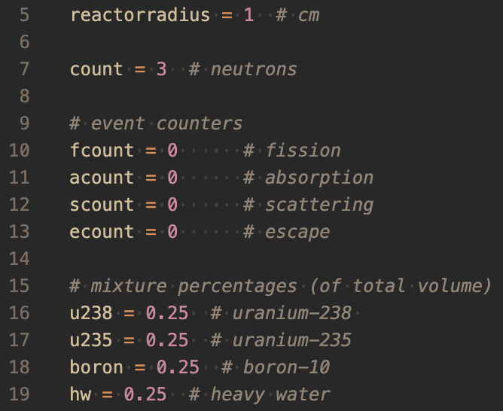
Inputs
01
02
03
Reactor Size
Number of Neutrons
Each given a position, “velocity,” and energy
Cross-Sections
What is this?

Slide 5
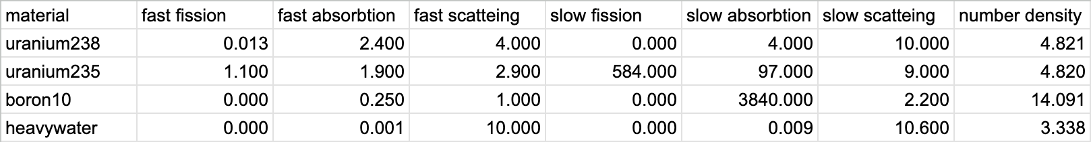
03
Nuclear Cross-Section
Fancy-speak for the probability that a nuclear event will occur

Slide 6

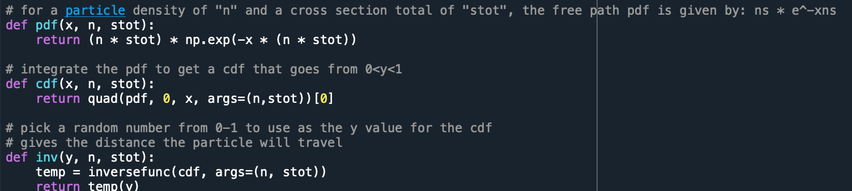
Cross-sections are areas
They are measured in barns (10^-28 m^2)
The probability for an interaction depends on the cross-section and the number density of the material

Slide 7
What events are Possible and How are they processed?
Fission: The neutron collides with a reactive element with sufficient energy
→ The fission event is counted and the neutron is removed from the simulation
Escape: The distance required for the neutron to react (probabilistically), is less than the distance to the edge of the reactor
→ The escape event is counted and the neutron is removed from the simulation

Slide 8
What events are Possible and How are they processed?
Absorption (Inelastic Collision): The neutron collides with an atom and sticks
→ The absorption event is counted and the neutron is removed from the simulation (noticing a pattern?)
Scattering (Elastic Collision): The neutron bounces off an atom and loses energy if it bounces off a light nucleus
→ The scattering event is counted and the neutron is run through the simulation recursively

Slide 9
Simulation Outputs
Number of each event: What does it tell us?
Fissions:
Amount of energy released / productivity of reactor
Absorptions / Scatterings:
Effects of control (boron) and moderator (heavy water) quantities on reaction rate / output

Slide 10
Our Code
1. Initial Conditions
2. Neutrons “spawned”
Reactor Radius
Cross-Sections
Number of Neutrons
Position
Velocity (Direction of Travel)
Energy Level
3. Time “ticked”
4. Check (again)
Neutrons are moved a distance until they (probabilistically) collide with something in the direction of “velocity”
Check if the distance of first collision is within the reactor
Determine which event occurs and repeat from (3) if necessary

Slide 11
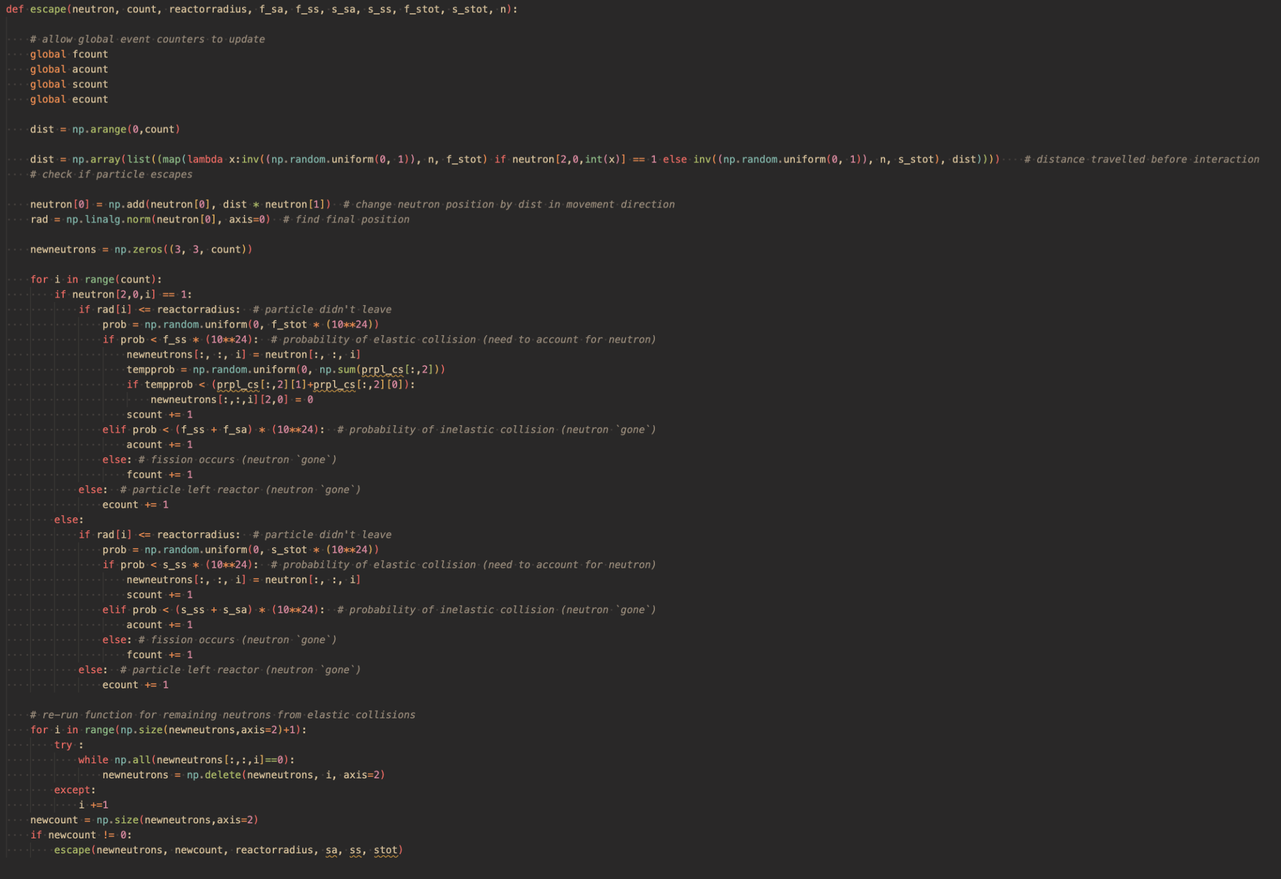

Slide 12
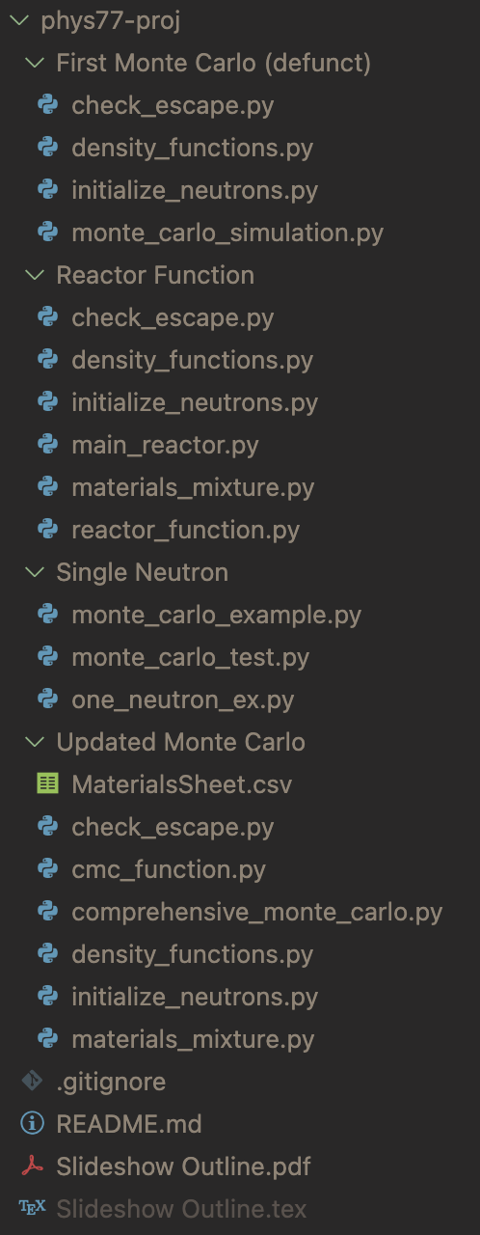
Take 1: Single Neutron
Take 2: First Monte-Carlo
Simulation of a single neutron to test functions and procedures
Issues:
Position and direction had 3 variables each
Neutron did not always spawn inside of reactor
Position and direction were turned into a (2, 3) array
Functions looped for each neutron
Issues:
Neutron spawning (still)
Probability density functions were not efficient to use multiple times
Loops were very slow for large ‘n’

Slide 13
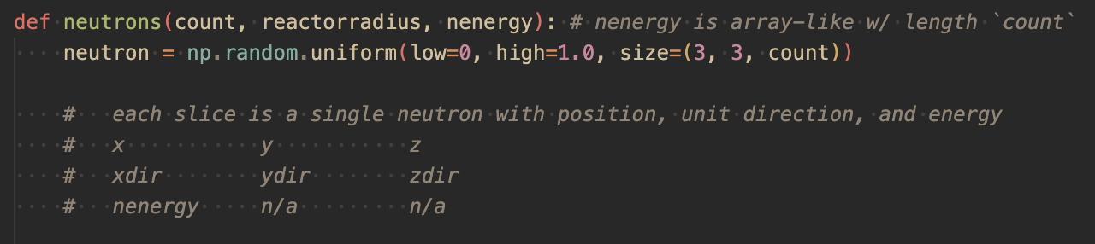
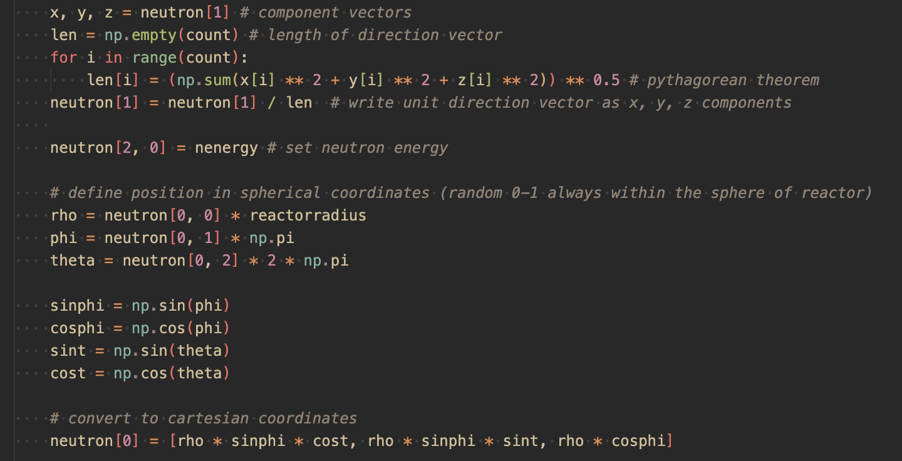
Solving Issues
Speed
Position
Neutrons processed in a 3d array (fewer loops
Measure randomness in spherical rather than cartesian coordinates

Slide 14
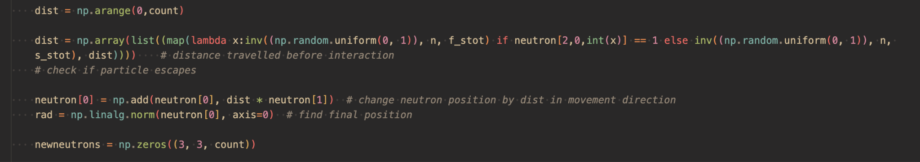
Solving Issues
Probability
Escape
Density functions tweaked to allow randomized inputs mapped across arrays
Testing final position (radius) sped up significantly through use of Frobenius Norm (finds magnitude of vector)

Slide 15
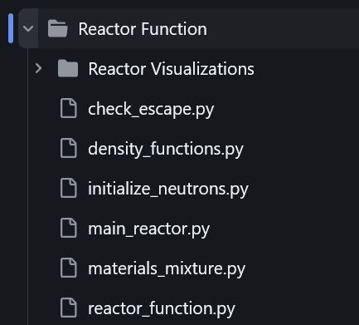
Conclusions For Reactor Base
Reactors involving mixed materials
Reactor function and putting everything together

Slide 16
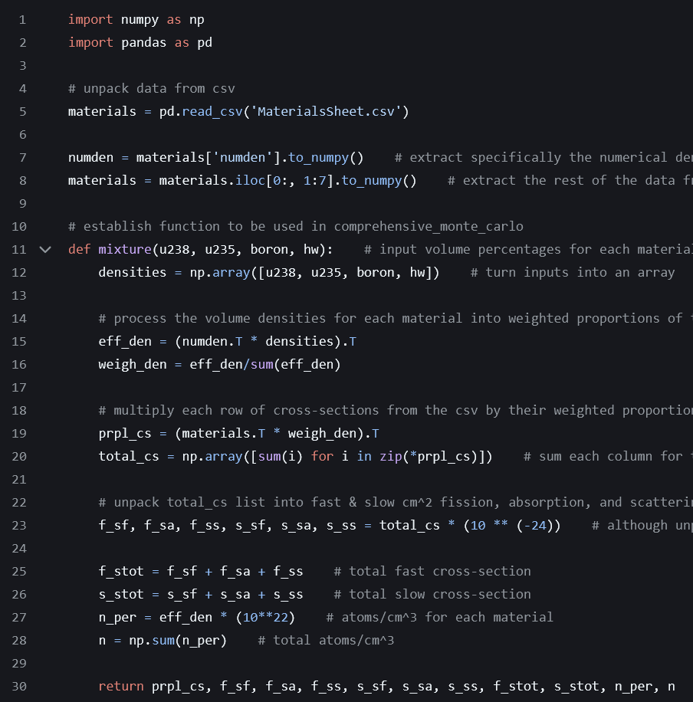
Materials_Mixture
Rather than just using the data for one material, we wanted to be able to the the interactions with a mixed reactor, allow us to account for enrichment, moderators, and control rods.

Slide 17
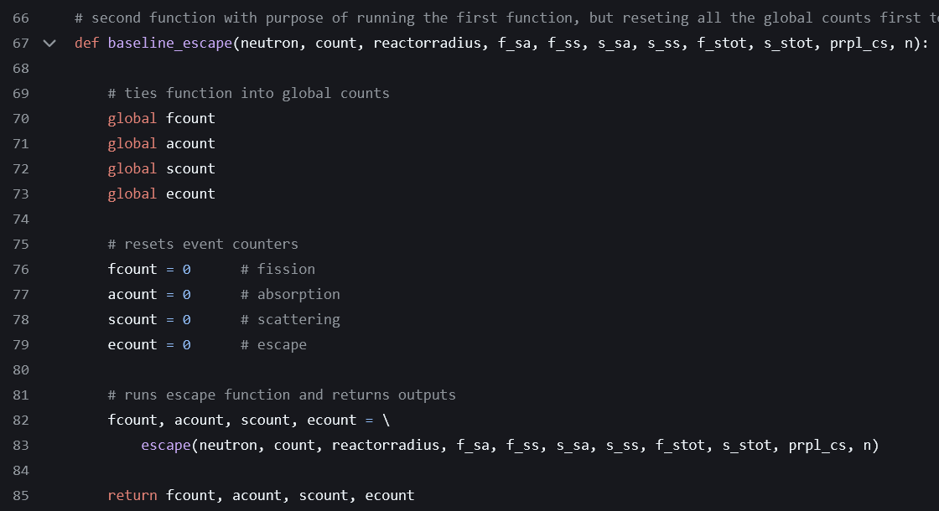

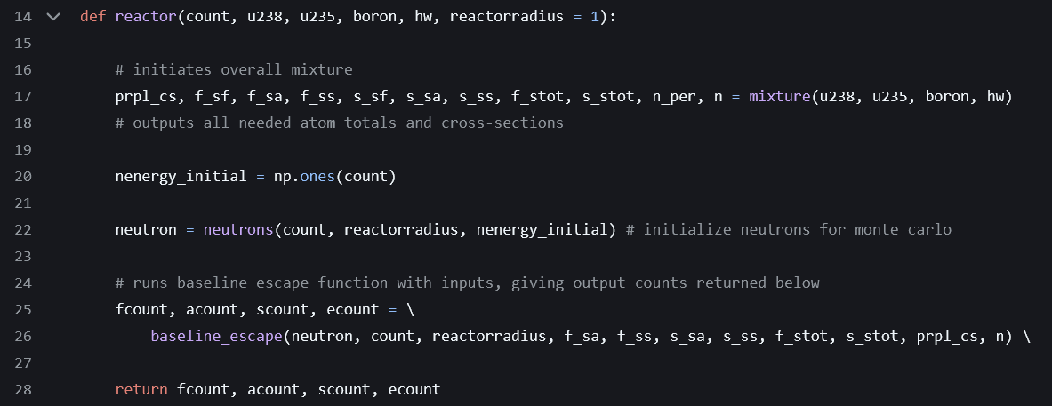
REactor_function
Put all the separate pieces together into a shared module
Interesting issue: global variables
Optimization extension

Slide 18
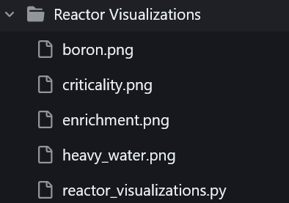
eXTENSIONS
Graphical representations
Antineutrinos
Criticality and other extensions

Slide 19
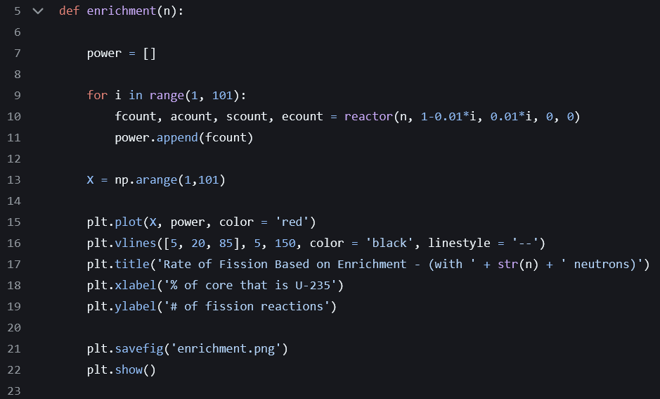
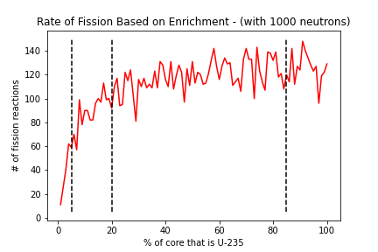
Enrichment Visualization
Clearly demonstrates the importance of different levels of enrichment:
Reactor vs. weapons-grade uranium

Slide 20
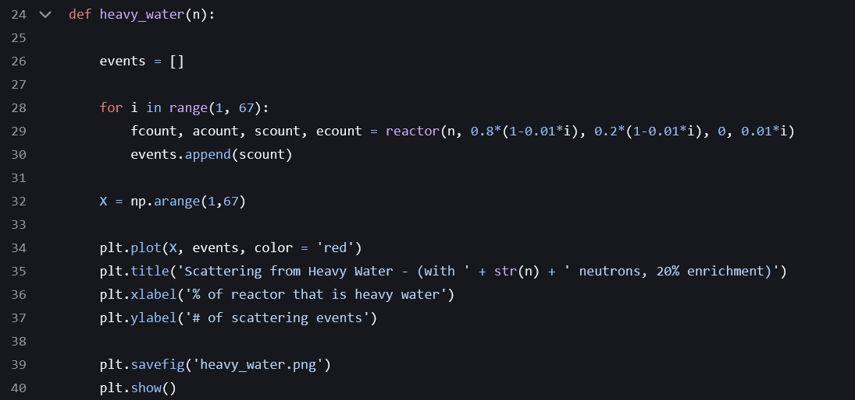
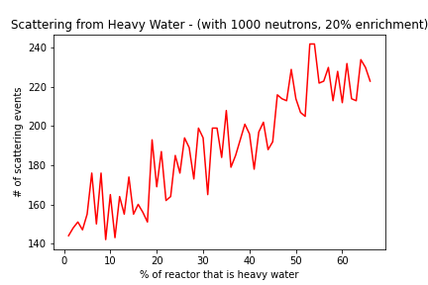
Heavy Water Visualization
Key insights about temperature, and interesting impacts on scattering

Slide 21
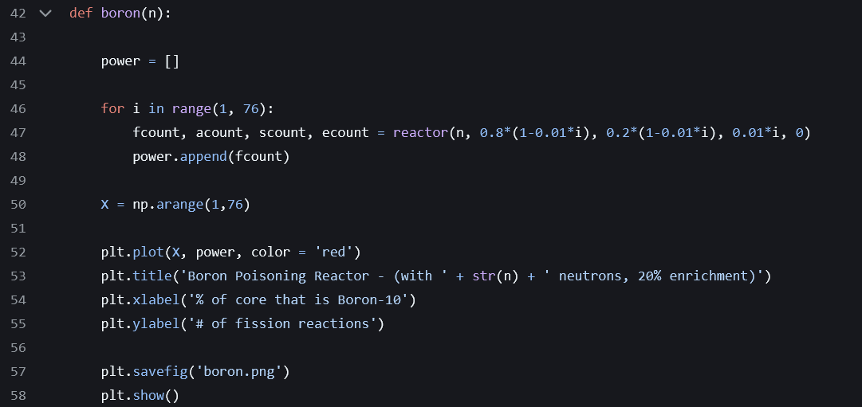
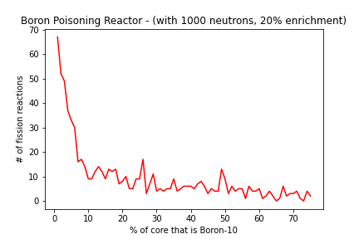
Boron Visualization
Poisoning the reactor!

Slide 22
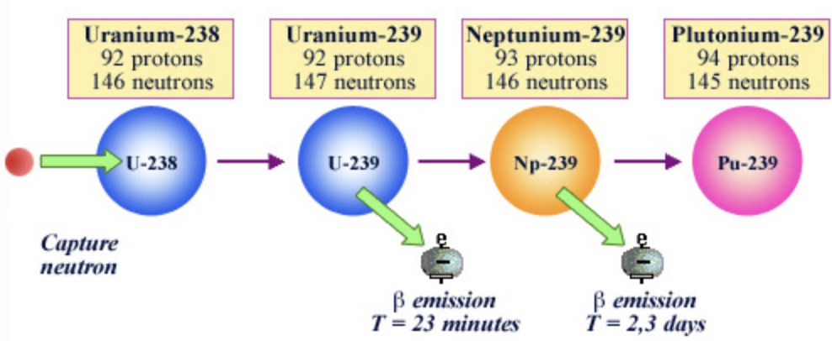
Antineutrinos
Fission products and uranium that absorbs a neutron will undergo beta decays, which release antineutrinos

Slide 23
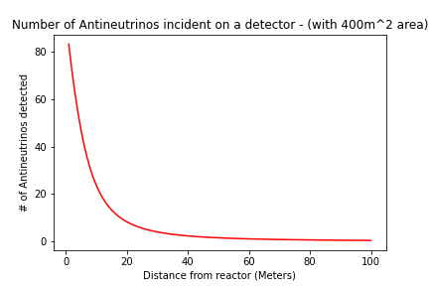
For a simulation with 1000 initial neutrons

Slide 24
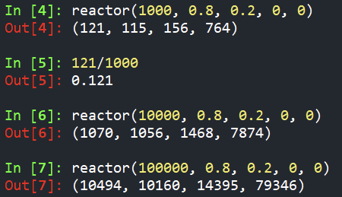
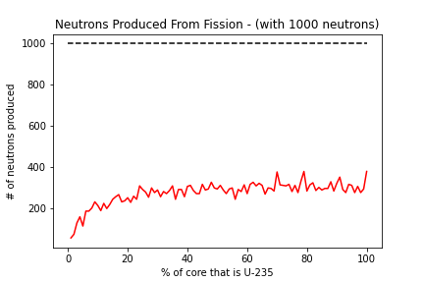
Criticality and other extensions
Criticality
Subcritical, critical and supercritical
Seemingly not simulating a critical reactor
Clearly greater complexity involved; however we were able to demonstrate various important principles
Temperature
Heavy water vs. water
Changing cross-sections w/ temp
Geometry
Shaping reactor beyond sphere
Control rods vs control substance
Water shell

Slide 25
Thank You!

